Slide 1

Topia Life Sciences, a technology-enabled diversified life science company.

Slide 2


WHY TOPIA?
Topia Life Sciences leads pharmaceutical innovation with SMAG. Our tailored solutions under TOPIA address evolving healthcare needs.
A VISION TO BUILD SMARTER HEALTHCARE
At Topia, we understand that every healthcare challenge is unique. That's why we offer integrated, tailored solutions to address specific needs.
Our vision is to improve the current conventional methods for managing compliance within the pharmaceutical and Biotech industries, reduce treatment time, and improve access to care.
We are passionately committed to accelerating the advancement of healthcare through the intelligence of technology.
www.topialifesciences.com

Slide 3

What We Do
Developing Novel molecules in Oncology, CNS, Cardio-vascular and metabolic disorders.
Providing AI leverage Drug Discovery Services.
SMAG Technology
Enhanced Efficiency
Increased Accuracy
Cost-Effective Solutions
Flexibility and Adaptability
Predictive Modelling

Slide 4
SMAG Methodology
04
02
Generation of novel molecules using computational models.
ADMET prediction of molecules
01
Performing the synthesis of the molecule.
05
Data collection and curation of an identified target.
Prioritization of molecules based on predictive bioactivity, docking, and synthetic accessibility score
03

Slide 5
Salient Points of SMAG
We have built a robust system which stand out from the available resources, as
01
SMAG can generate novel molecules for any target, instead of screening the chemical space.
Shortlisting the hit molecules with data-centric method.
Predicting the toxicity based on the computational model built on commercial data.
Score Predicting the ADME properties and Toxicity based on the AI models
02
03
04

Slide 6
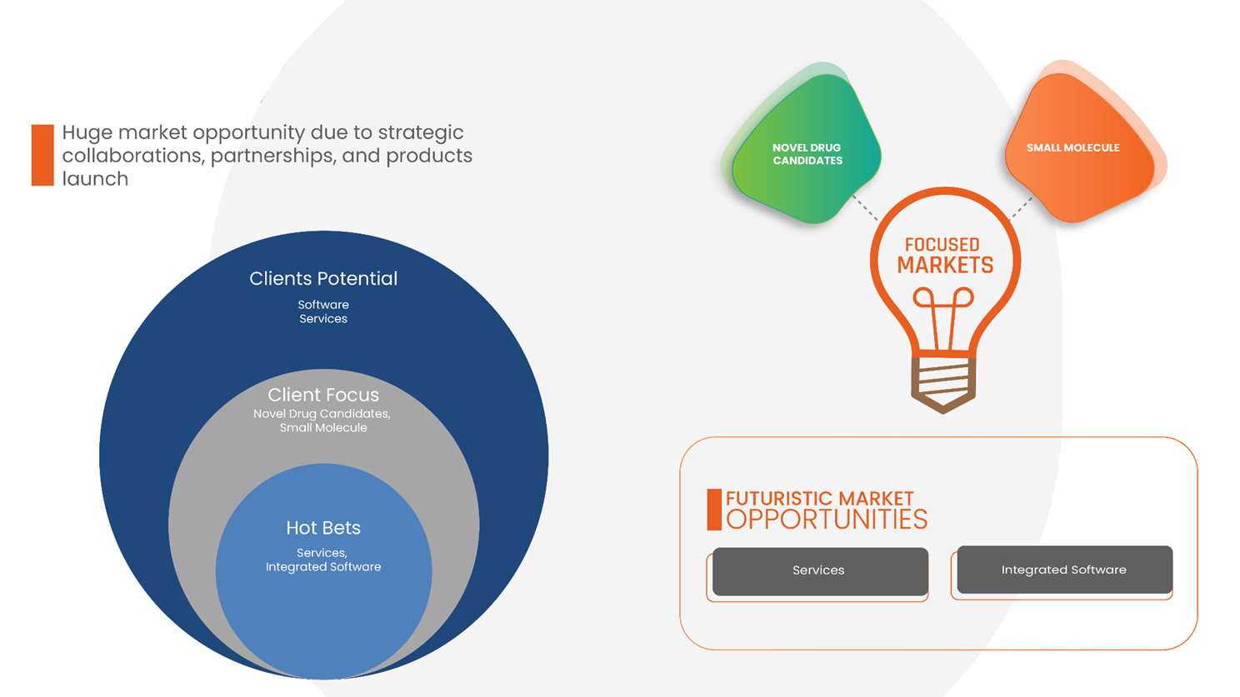
Key Products and Services

Slide 7
Comparative Advantage of Topia’s SMAG Methodology
Works with simple SMILES representation
02
Automate the process of molecule generation for desired targets
PROS OF OUR MODEL
Learns important features on its own rather depending on external calculated properties
01
03

Slide 8

Process Flow of SMAG
01
Data Generation, Data Cleaning
QSAR (Quantitative Structure-Activity Relationship Models)
ADME Prediction
Toxicity Prediction
Retro Synthesis
02
03
04
05

Slide 9
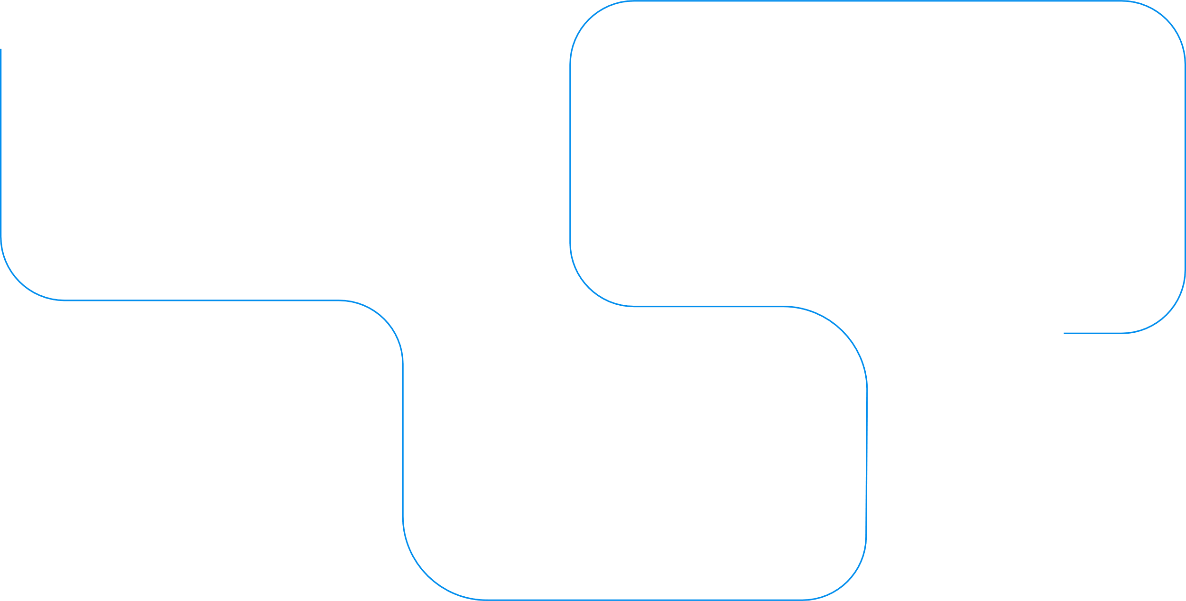
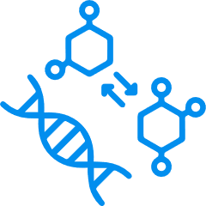
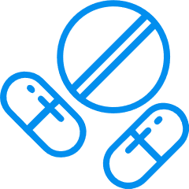

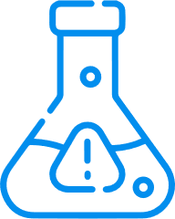

TOPIA’s Service Technologies
04
05
Retrosynthesis
Drug Repurpose
01
03
Data Generation
Toxicity
02
QSAR

Slide 10
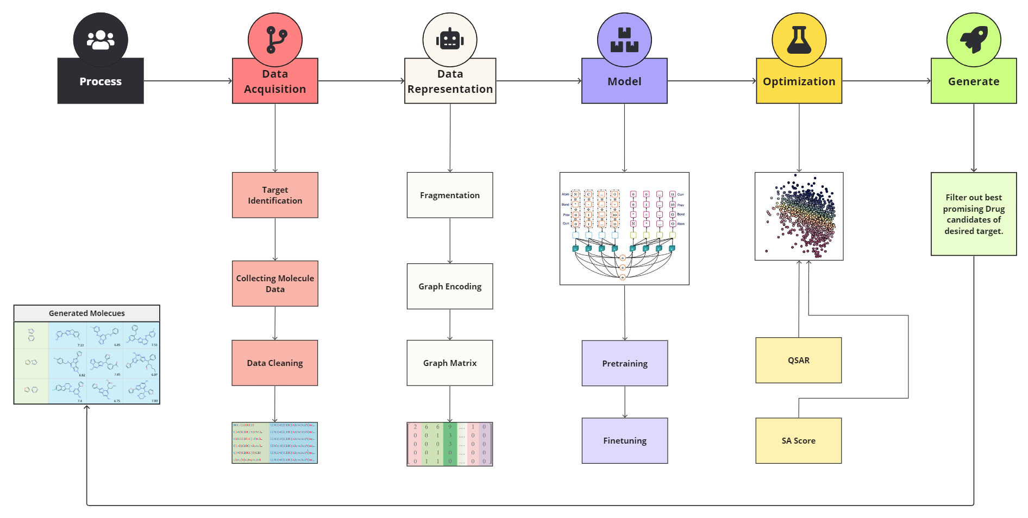
Molecules Generation Model Process Flow

Slide 11
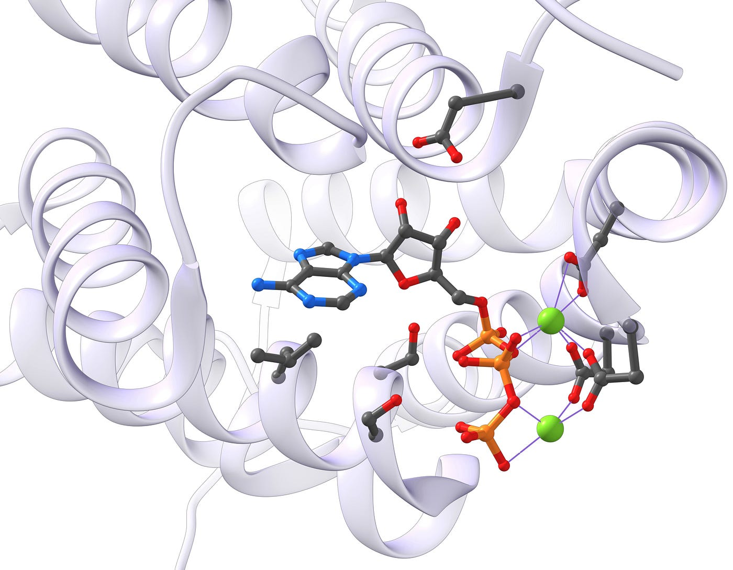
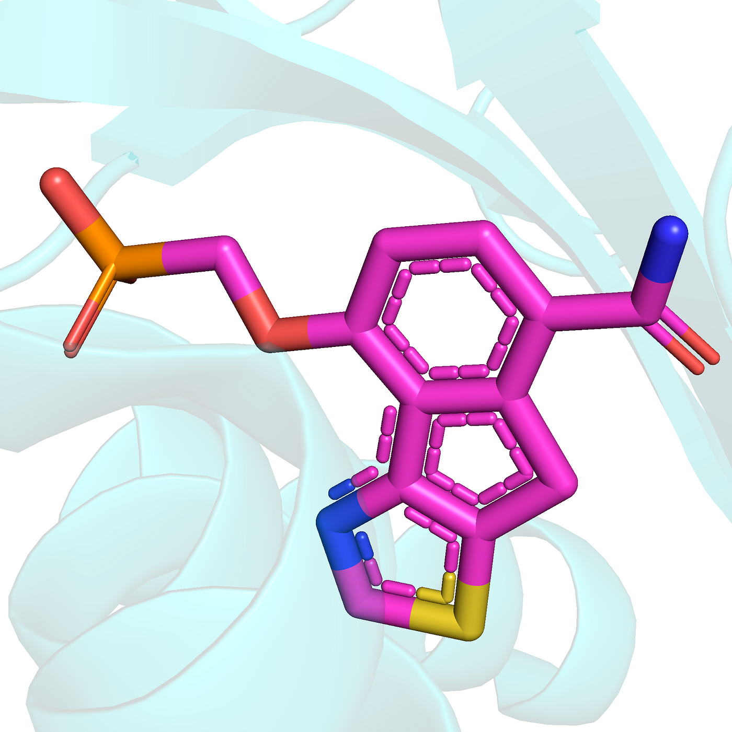
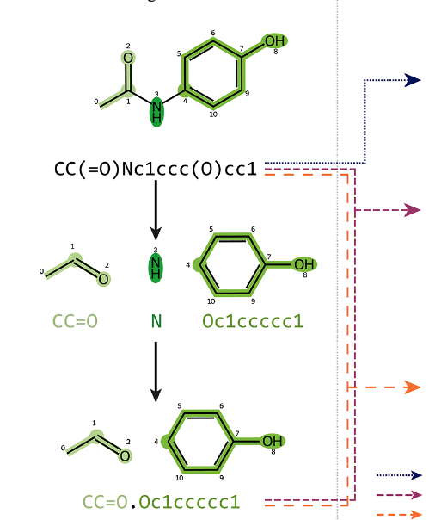
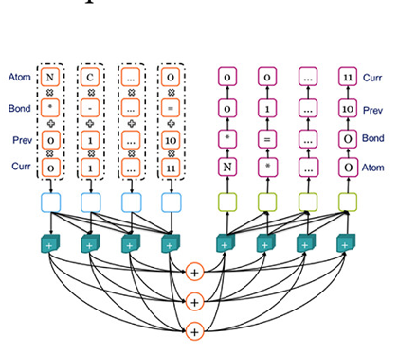


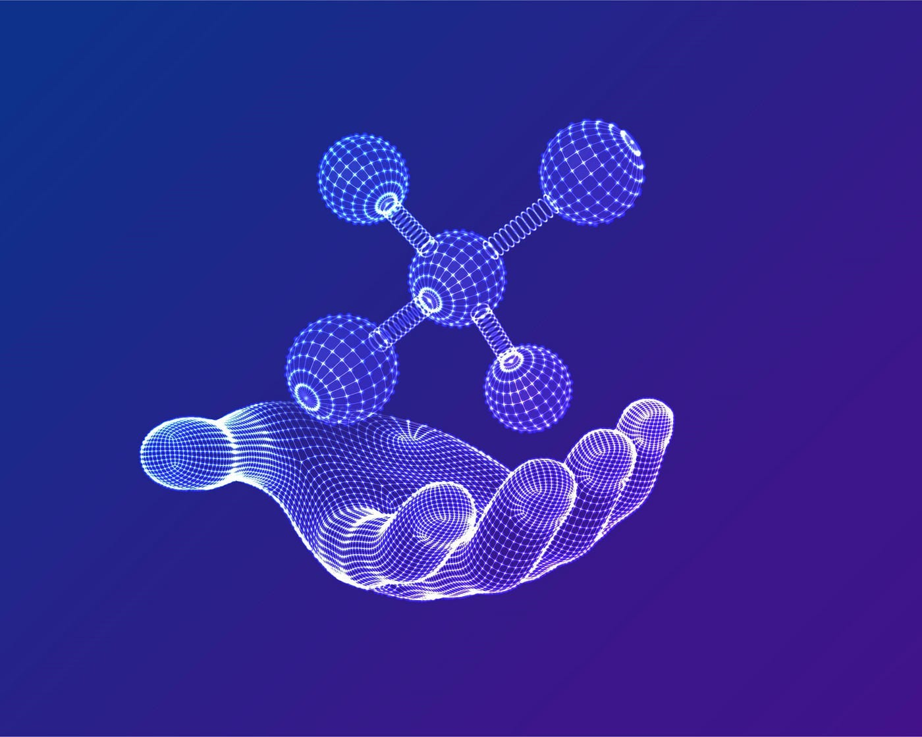
Molecules Generation Model Architecture
Compound
Data
Standardize
Clean
Encode
Graph
Transformer
Model
Pretrain-
Finetune
Reinforce
(QSAR+SA)
Generate
Molecules

Slide 12
Description of Molecule Generation Architecture
Compound Data
The model uses compound data for its training, likely sourced from ChEMBL, which contains drug-like molecules.
Standardize Clean
Standardization ensures that only organic molecules are kept in the dataset, removing any inorganic or non-standard molecules.
Encode
Encoding of molecules is performed differently for a graph-based model, with the latter combining the atom index (current position) and connected atom index (previous position).
Model
The model architecture includes a transformer encoder and a GRU-based decoder, focusing on graph representations of molecules.
Pretraining-Finetuning
Before targeting specific chemical properties, the generator is pre-trained on a large set of drug-like molecules, allowing it to learn the language of drug-like compounds and generate reasonable molecules. Fine-tuning can then direct the generator toward desired chemical spaces.
Reinforce
Reinforcement learning is employed to quantify the desirability of generated molecules based on various properties. The generator is optimized using a policy gradient scheme.
Generate molecules
The ultimate goal is to generate molecules that fulfil specific objectives defined in the training, such as desired properties or adherence to certain chemical rules.

Slide 13
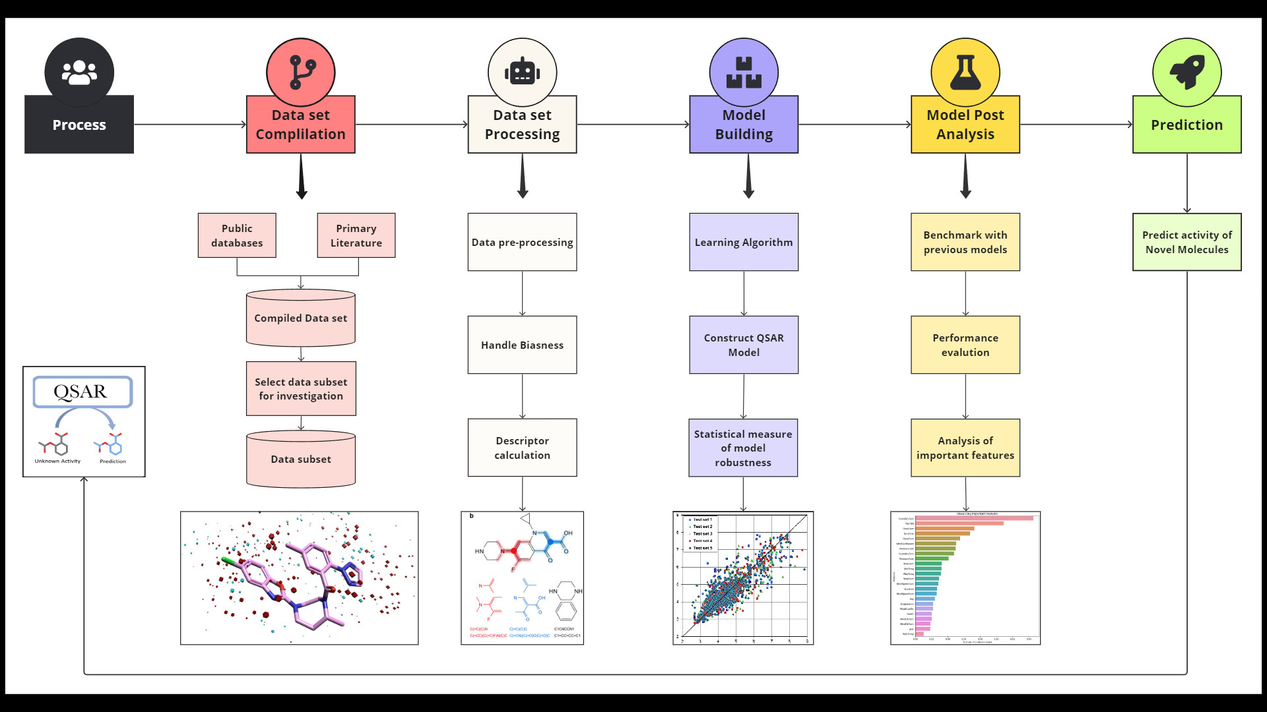
QSAR Model Process Flow

Slide 14
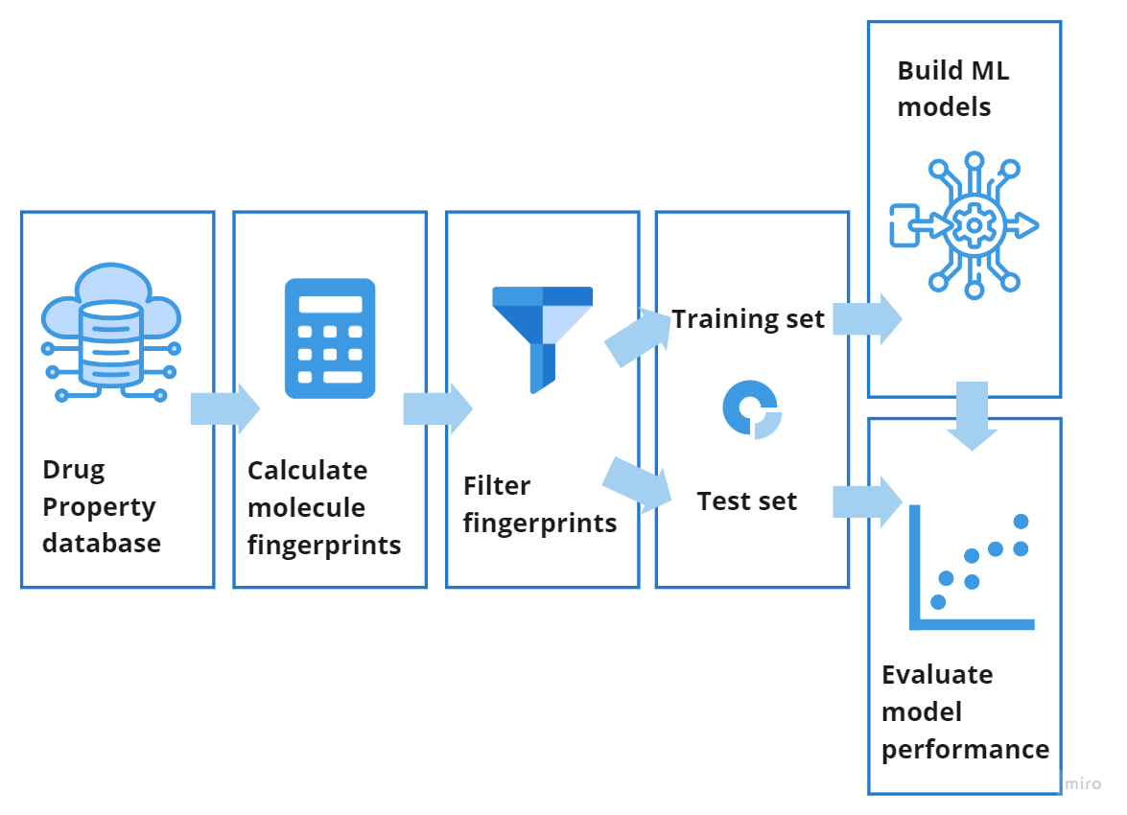
QSAR Model Architecture

Slide 15
Description of QSAR Model Architecture
Data Splitting: The model is trained on 80% of the data and validated on the remaining 20% in each fold, ensuring robustness and generalization.
Drug property database: A comprehensive database of drug properties is utilized for Quantitative Structure-Activity Relationship (QSAR) prediction, aiding in understanding the relationship between chemical structure and biological activity.
06
01
QSAR Model
Architecture
ML regression model: A Random Forest regression model is employed for predicting the quantitative properties of molecules based on their fingerprints. Random Forest is chosen for its ability to handle complex data relationships and provide robust predictions.
Calculate molecule fingerprints: Extended Connectivity Fingerprints (ECFP4) are computed for each molecule in the dataset, encoding structural information to represent molecular features.
05
02
Evaluate Model: The performance of the regression model is evaluated using the coefficient of determination (R2 score) and Mean Squared Error (MSE) analysis.
Filter fingerprints: Fingerprints are filtered to extract relevant features or patterns that contribute significantly to the target property prediction, reducing noise and improving model performance.
04
03

Slide 16
Toxicity Model Process
Literature review
Data collection and cleaning
Model development
Model validation
Model optimization
Relevant toxicity/ endpoints
Data fetching (eg. DrugBank ,ChEMBL, PubChem etc.)
Data preprocessing
Testing dataset collection
Model hyper parameter tune
Types of model architecture
Feature engineering
Testing and evaluation
Data gathering
Scrapping data from literature
Data sources
Model building and cross validation
Model selection
Model re-training and enhancement
Data annotation
Model performance
Standardizing dataset (eg. Canonicalization)
Model evaluation and assessment
Model evaluation

Slide 17
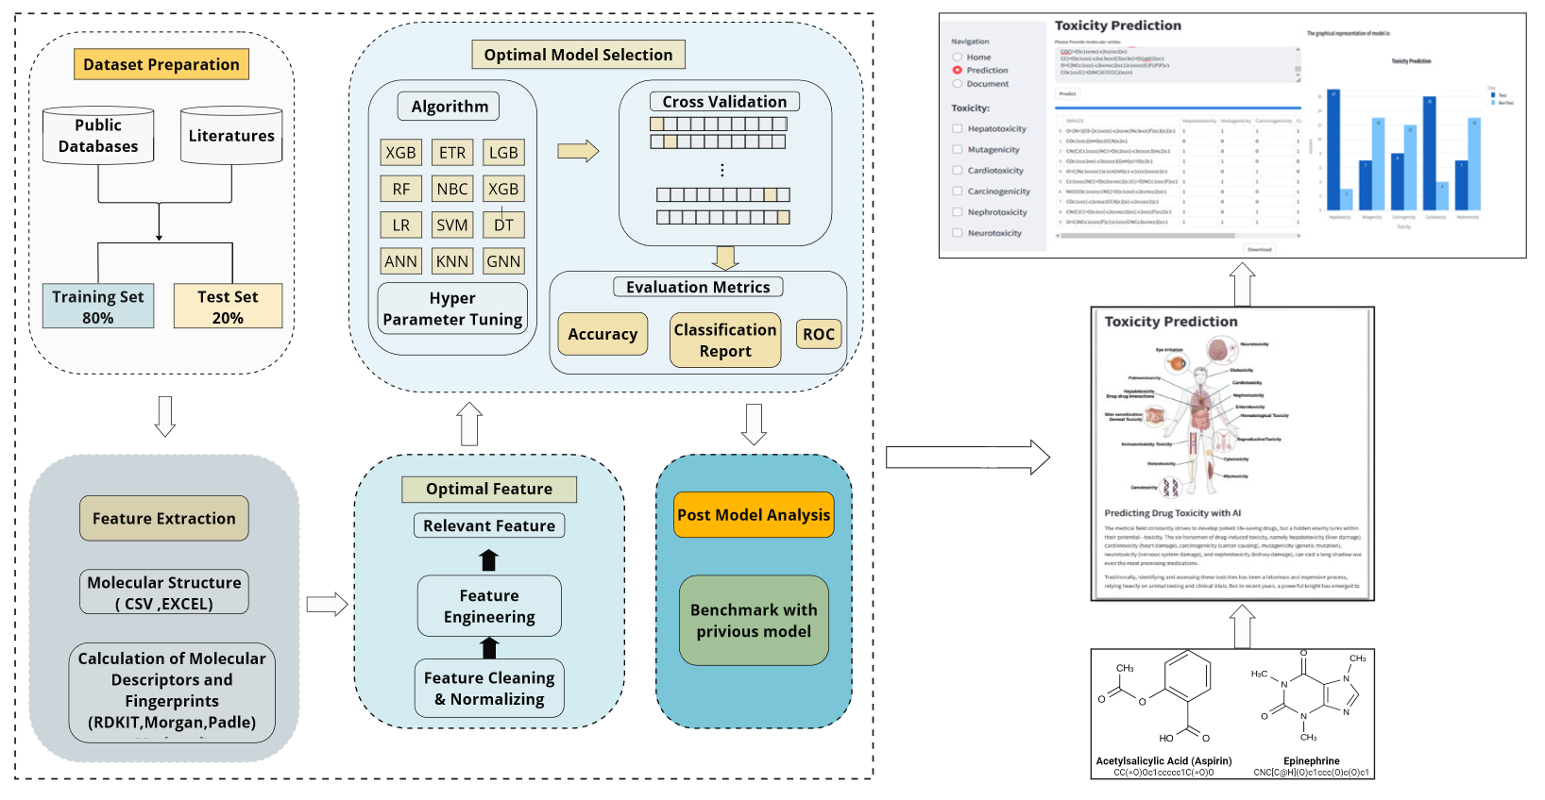
Toxicity Model architecture

Slide 18

Toxicity Model architecture
Drug-induced toxicity, refers to the harmful effects drugs can have on the body when taken at specific doses.
These effects can range from mild discomfort to life-threatening conditions, impacting major organs of the body such as the liver (hepatotoxicity), kidneys (nephrotoxicity), and heart (cardiotoxicity).
Some molecular structure of drugs even have the potential to cause cancer (carcinogenicity) and genetic mutations (mutagenicity).
Identifying the toxicity of drugs has been a lengthy process, to ease this difficulty machine learning, deep learning models and graph-based neural network models are employed.
These advanced models can analyse massive datasets, and identify hidden patterns that can predict potential drug toxicity.
This translates into significant benefits such as accelerate safer drug development process, reduced reliance on animal testing, and ultimately, a healthier future for all.

Slide 19
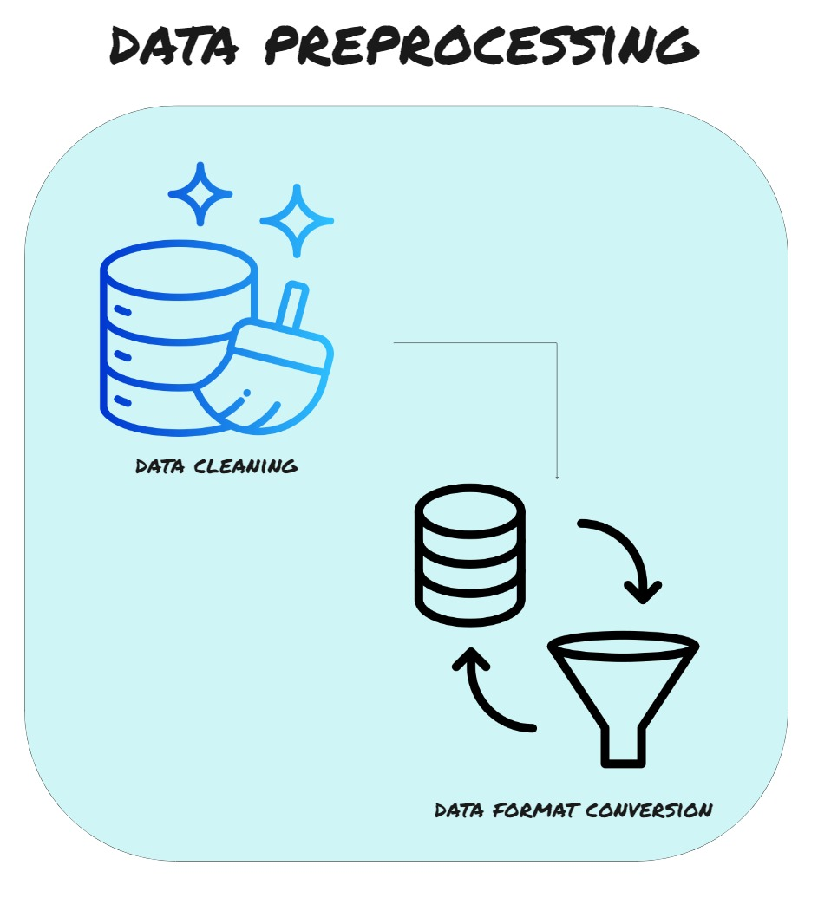
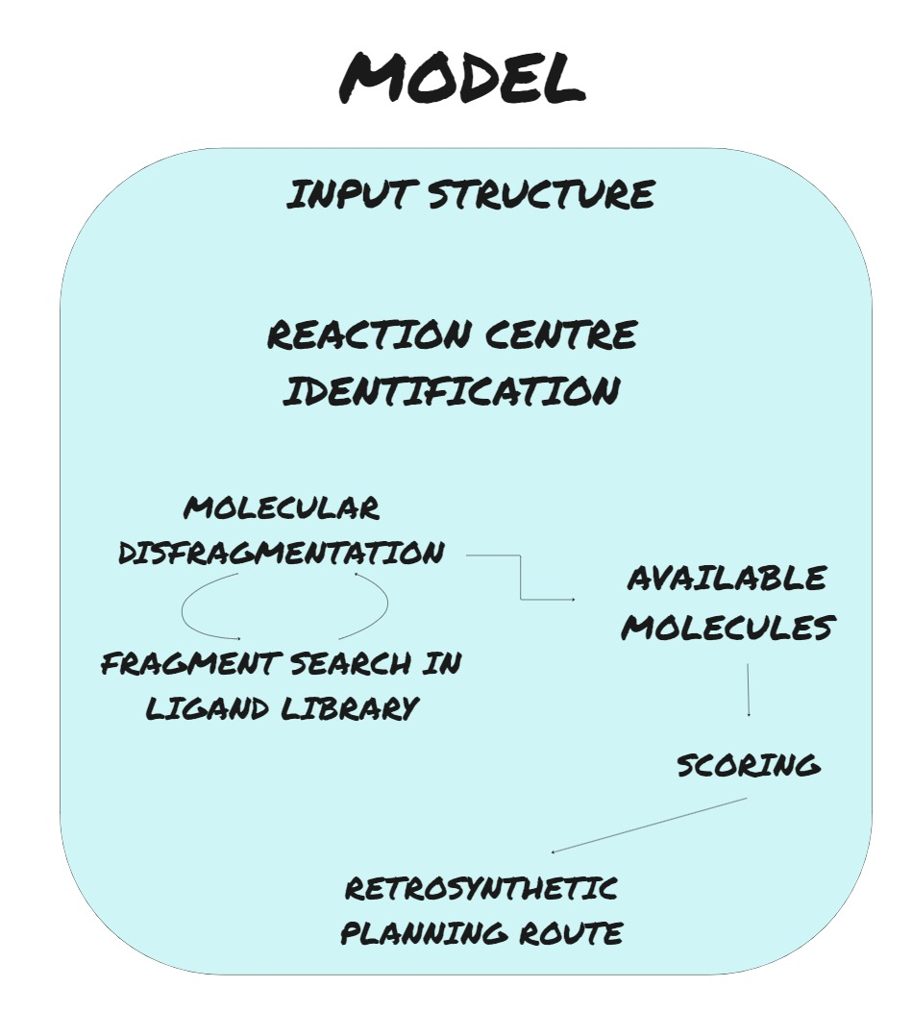
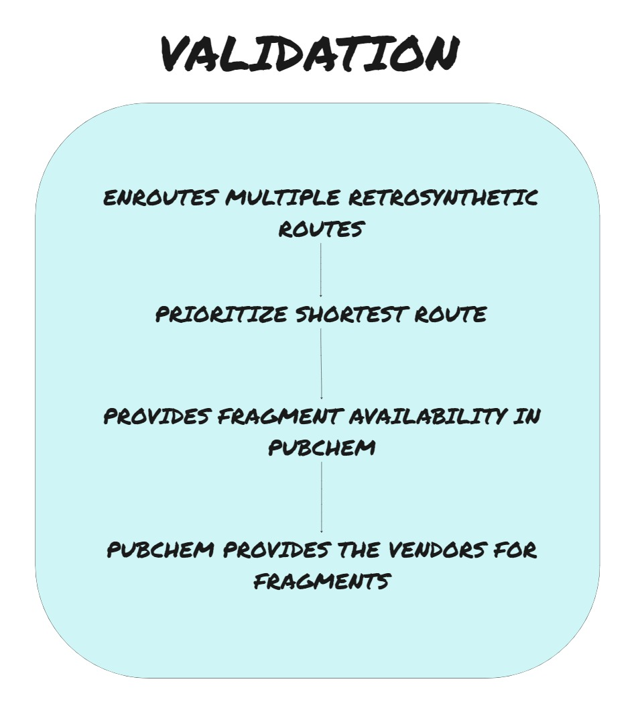
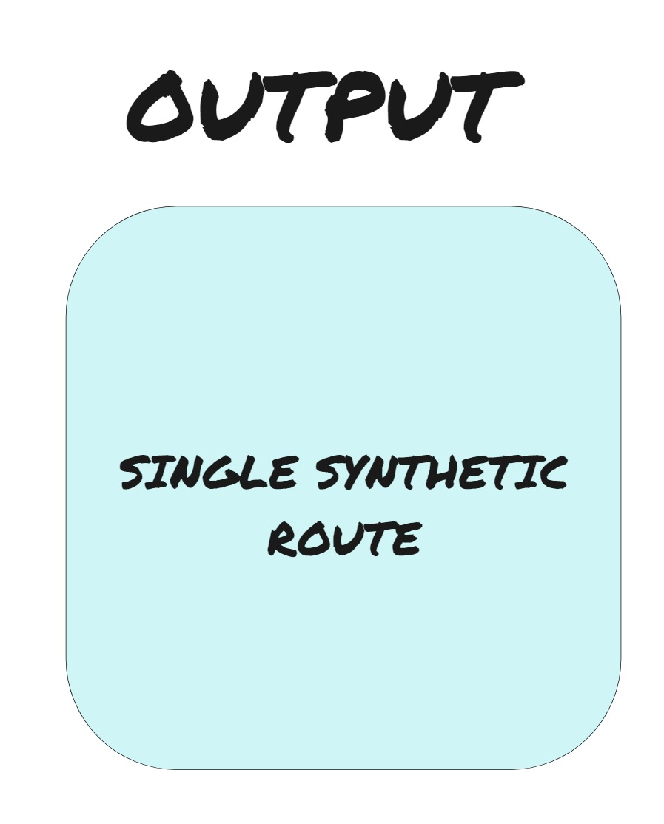
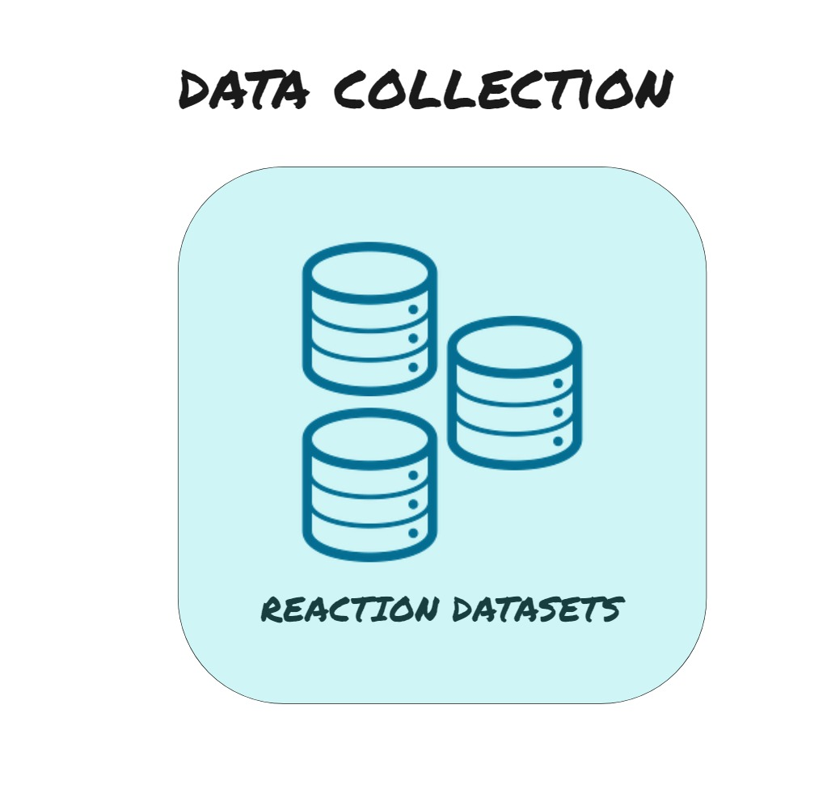
Retrosynthesis Process Flow

Slide 20
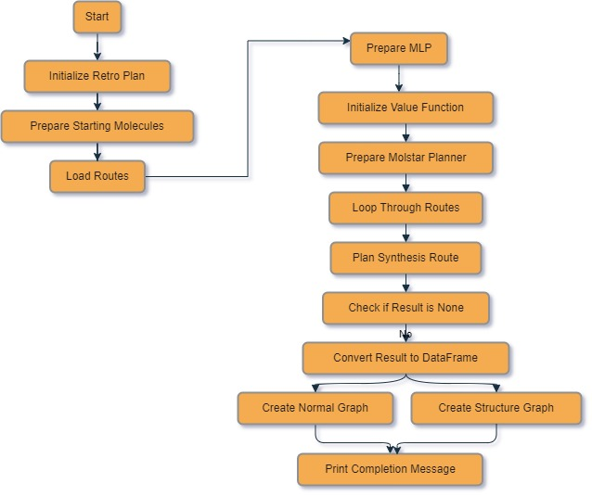
Retrosynthesis Model Architecture

Slide 21





Process Explanation
Data Collection: A comprehensive data of valid chemical reactions were gathered from various sources like USPTO, MIT Dataset and many more. This data would serve as the knowledge-base of the model for reaction and reaction feasibility.
Data Preprocessing: This includes two different individual steps
1) Data Cleaning: Here, all the reactions were overviewed and faulty data, chemically invalid data and duplicate data were treated and curated;
2) Data Conversion: Here, the reaction SMILES are converted to a specific SMILE format that includes atomic position and connectivity information.
Model: Model performs five different functions:
1) Reaction Centre Identification: This step actually identifies a center where a chemical reaction can occur to connect the two fragments; 2) Defragmentation: Once the center is identified it breaks the molecules into two corresponding synthons;
3) Library Search: The model simultaneously searches chemical libraries for the availability of the fragments formed;
4) Scoring: It scores ever chemical reaction involved into the route for its feasibility;
5) Plan Development: Based on the score of each step it prioritizes the shortest route and provides an output.
Validation: The obtained results are validated by testing the availability of the fragments on PubChem and look for the vendors for same fragments.
Output: It provides a final retrosynthetic route in a form of PDF file with its chemical structure, reaction feasibility scoring and a binary outcome of its availability on PubChem

Slide 22
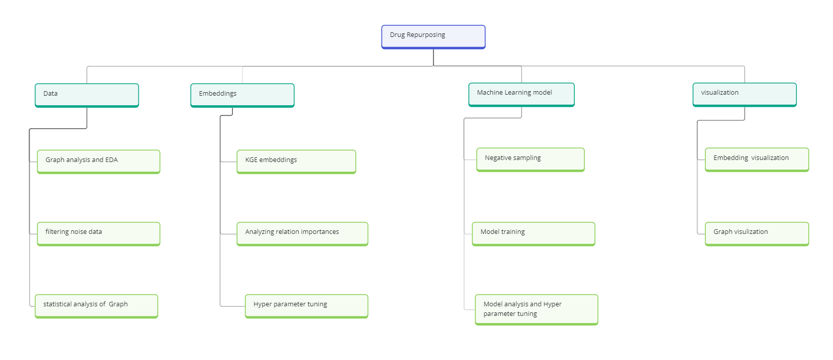
Process flow of Drug Repurposing

Slide 23
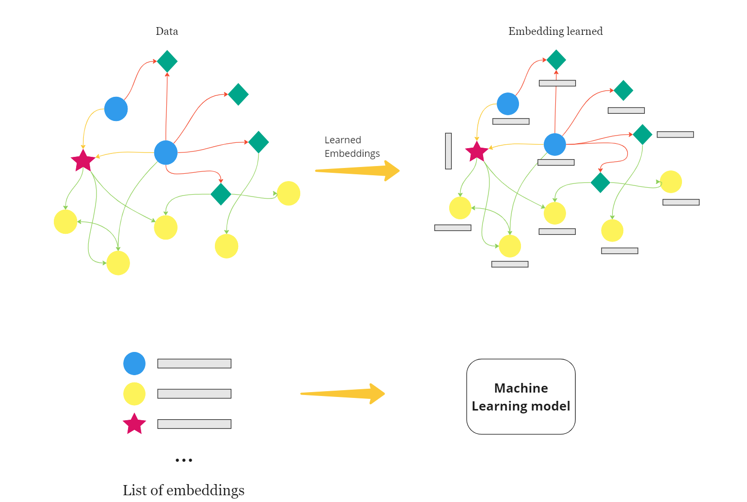
Drug Repurposing Architecture

Slide 24
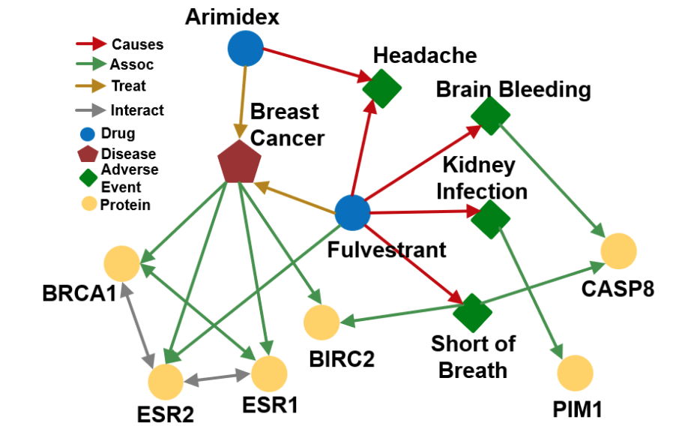
Knowledge Graph for Repurposing
Knowledge graphs are powerful heterogenous graphs that connects data to visually represent a network of entities and relationships. Importantly, knowledge graphs capture facts.
Knowledge Graph has many missing links in-between nodes, we try to complete the knowledge graph by predicting missing links
We calculate the embeddings for each nodes
Then try to predict link based on Machine learning models

Slide 25
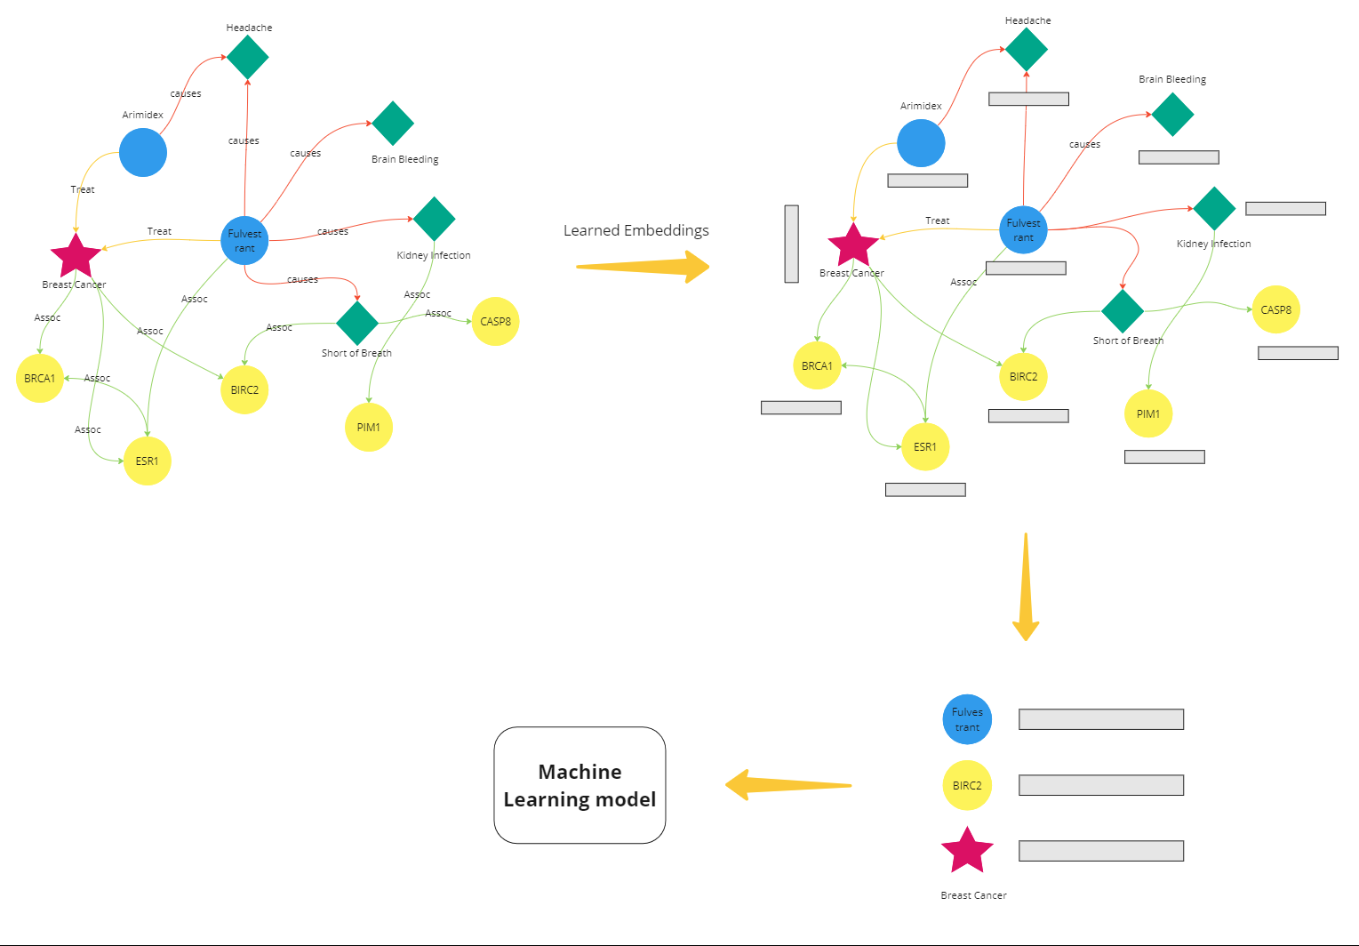

Slide 26
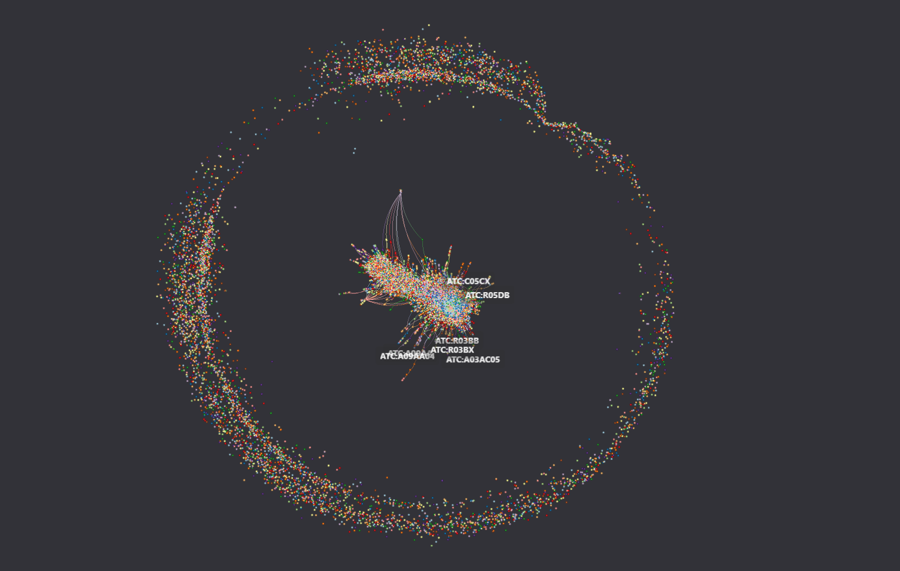
Graph visualization
Link :

Slide 27

Thank
You!
www.topialifesciences.com

